Slide 1

Comparative Study of NLP Models and Algorithms
Presented by:
S. Sri Sai Prasanna Durga (192424241)
DSA0307-Natural Language Processing
Guided By:
Dr. Anbazhagan. K

Slide 2
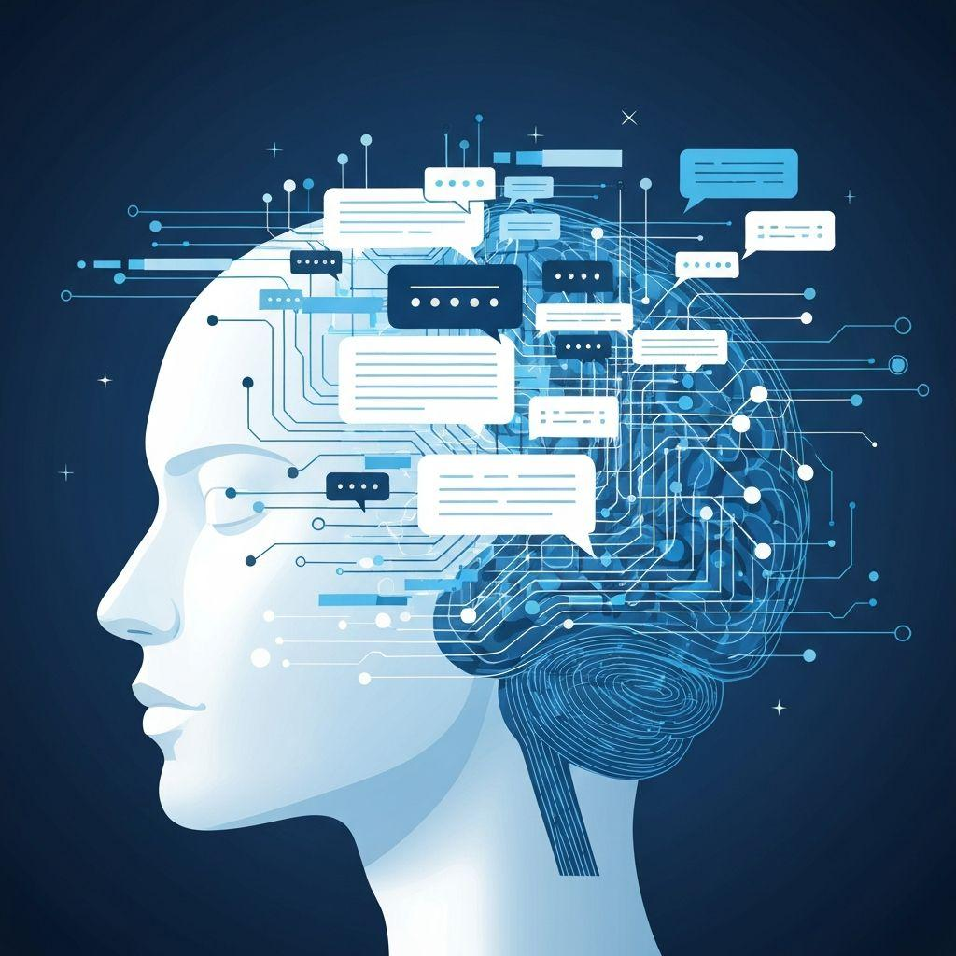
INTRODUCTION
What is NLP?
Natural Language Processing (NLP) is a branch of Artificial Intelligence that enables computers to understand, interpret, and generate human language. It combines linguistics, machine learning, and deep learning to process text and speech.
Applications
Chatbots
Google Translate
Voice Assistants
Sentiment Analysis
Spam Detection

Slide 3
TRADITIONAL NLP MODELS
Bag of Words (BoW)
Counts word frequency.
Fast and simple.
Ignores word order.
TF-IDF
Identifies important words.
Better than BoW for document comparison.
N-grams
Uses sequences of words.
Captures local context.

Slide 4
MACHINE LEARNING VS DEEP LEARNING MODELS
Machine Learning Models
Naive Bayes:
Fast and simple for text classification.
Commonly used in spam detection.
Support Vector Machine (SVM):
High accuracy for sentiment analysis and document classification.
Works well with high-dimensional text data.
Deep Learning Models
RNN (Recurrent Neural Network):
Processes text sequentially.
Remembers previous words in a sentence.
LSTM (Long Short-Term Memory):
Solves the limitations of RNN.
Captures long-term dependencies in text.

Slide 5
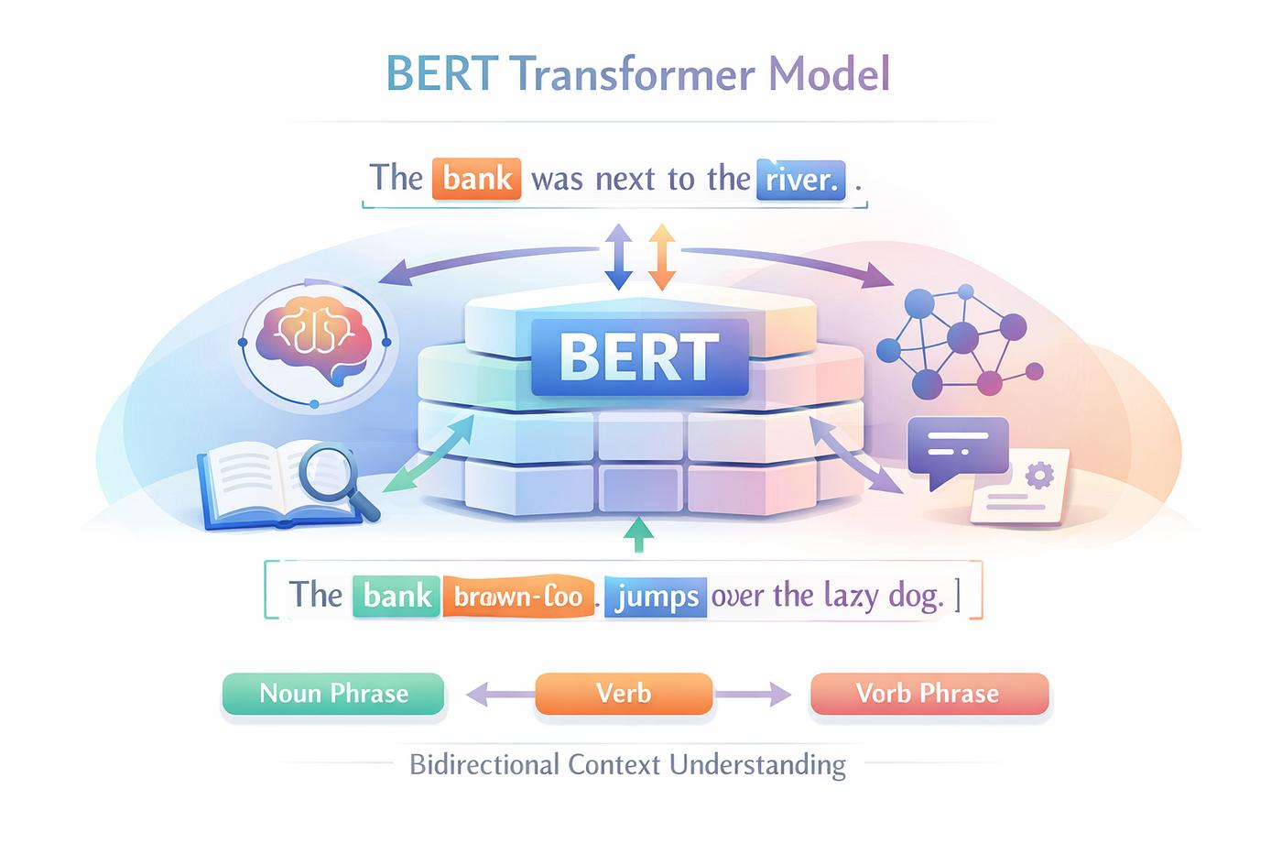
TRANSFORMER MODELS
BERT:
Reads text in both directions.
Best for text classification and question answering.
GPT:
Generates human-like text.
Used in ChatGPT and content generation.
RoBERTa:
Improved version of BERT.
Higher performance on many NLP tasks.

Slide 6
CONCLUSION
NLP enables computers to understand human language.
Traditional models (BoW, TF-IDF) are efficient for simple tasks.
Deep learning models (LSTM, GRU) improve context understanding.
Transformer models (BERT, GPT) achieve the highest accuracy and power modern NLP applications.

Slide 7


